Slide 1
Lecture 2: Systems and Network Security CSE 628/628A
Sandeep K. Shukla
Indian Institute of Technology Kanpur

Slide 2
Lecture 1: Control Hijacking
Total 6 Modules on Control Hijacking
Module 1.1: Basic Control Hijacking Attacks : Buffer Overflow
Module 1.2: Integer Overflow
Module 1.3: Formal String Vulnerability
Module 1.4: Defenses Against Control Hijacking – Platform Based Defenses
Module 1.5: Run-Time Defenses
Module 1.6: Some Advanced Control Hijacking Attacks

Slide 3
Module 1.1: Control Hijacking
Stack Smashing, Integer Overflow, Formal String attacks, Heap Based Attacks

Slide 4
Acknowledgements
Dan Boneh (Stanford University)
John C. Mitchell (Stanford University)
Nicolai Zeldovich (MIT)
Jungmin Park (Virginia Tech)
Patrick Schaumont (Virginia Tech)
Web Resources

Slide 5

Basic Control Hijacking Attacks
Control Hijacking

Slide 6
Example 1
#include <stdlib.h>
#include <unistd.h>
#include <stdio.h>
int main(int argc, char **argv) { volatile int modified;
char buffer[64];
modified = 0;
gets(buffer);
if(modified != 0) {
printf("you have changed the 'modified' variable\n"); }
else {
printf("Try again?\n");
}
}
$echo `python -c 'print("A"*64)'` | ./stack0
Try again?
$echo `python -c 'print("A"*65)'` | ./stack0
you have changed the 'modified' variable

Slide 7
Example 2
$./`python -c 'print("A"*64 + "\x64\x63\x62\x61")'` |./stack1
you have correctly got the variable to the right value

Slide 8
Example 3
$export GREENIE=`python -c 'print("A"*64 + "\x0a\x0d\x0a\x0d")'`
$ ./stack2
you have correctly modified the variable

Slide 9
Example 4
$ nm ./stack3 | grep win 08048424 T win
$ ruby -e 'print "X" * 64 + [0x08048424].pack("V")' | ./stack3
calling function pointer, jumping to 0x08048424
code flow successfully changed

Slide 10
Control hijacking attacks
Attacker’s goal:
Take over target machine (e.g. web server)
Execute arbitrary code on target by hijacking application control flow
Examples.
Buffer overflow attacks
Integer overflow attacks
Format string vulnerabilities

Slide 11
Example 1: buffer overflows
Extremely common bug in C/C++ programs.
First major exploit: 1988 Internet Worm. fingerd.
20% of all vuln.
Source: NVD/CVE

Slide 12
What is needed
Understanding C functions, the stack, and the heap.
Know how system calls are made
The exec() system call
Attacker needs to know which CPU and OS used on the target machine:
Our examples are for x86 running Linux or Windows
Details vary slightly between CPUs and OSs:
Little endian vs. big endian (x86 vs. Motorola)
Stack Frame structure (Unix vs. Windows)

Slide 13
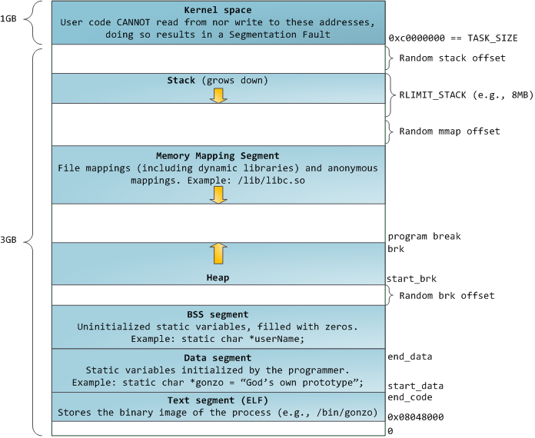
Linux Process Memory Layout
Notes:
BSS = Block Started by Symbol

Slide 14
Stack Frame http://post.queensu.ca/~trd/377/tut5/stack.html
high
arguments
return address
stack frame pointer
exception handlers
local variables
Stack
Growth
callee saved registers
SP
low

Slide 15
What are buffer overflows?
Suppose a web server contains a function:
void func(char *str) { char buf[128];
strcpy(buf, str); do-something(buf); }
When func() is called stack looks like:
argument: str
return address
stack frame pointer
char buf[128]
SP

Slide 16
What are buffer overflows?
What if *str is 136 bytes long?
After strcpy:
void func(char *str) { char buf[128];
strcpy(buf, str); do-something(buf); }
argument: str
return address
stack frame pointer
*str
char buf[128]
Problem: no length checking in strcpy()
SP

Slide 17
Basic stack exploit
Program P
high
Suppose *str is such that after strcpy stack looks like:
Program P: exec(“/bin/sh”)
When func() exits, the user gets shell !
Note: attack code P runs in stack.
return address
char buf[128]
low

Slide 18
The NOP slide
Program P
high
Problem: how does attacker determine ret-address?
Solution: NOP slide
Guess approximate stack state when func() is called
Insert many NOPs before program P:
nop , xor eax,eax , inc ax
NOP Slide
return address
char buf[128]
low

Slide 19
Details and examples
Some complications:
Program P should not contain the ‘\0’ character.
Overflow should not crash program before func() exits.
https://www.us-cert.gov/ncas/alerts/TA16-187A
(in)Famous remote stack smashing overflows:
(2007) Overflow in Windows animated cursors (ANI). LoadAniIcon() https://www.sans.org/reading-room/whitepapers/threats/ani-vulnerability-history-repeats-1926
(2005) Overflow in Symantec Virus Detection
test.GetPrivateProfileString "file", [long string]
Notes:
Animated cursor on web page or email message would result in arbitrary code execution. Used for rendering cursors, animated cursors, and icons.

Slide 20
Many unsafe libc functions
strcpy (char *dest, const char *src)
strcat (char *dest, const char *src)
gets (char *s)
scanf ( const char *format, … ) and many more.
“Safe” libc versions strncpy(), strncat() are misleading
e.g. strncpy() may leave string unterminated.
Windows C run time (CRT):
strcpy_s (*dest, DestSize, *src): ensures proper termination

Slide 21
Buffer overflow opportunities
Exception handlers: (Windows SEH attacks)
Overwrite the address of an exception handler in stack frame.
Function pointers: (e.g. PHP 4.0.2, MS MediaPlayer Bitmaps)
Overflowing buf will override function pointer
Longjmp buffers: longjmp(pos) (e.g. Perl 5.003)
Overflowing buf next to pos overrides value of pos.
Heap or stack
buf[128]
FuncPtr
Notes:
Windows media player bitmaps (skins) – heap overflow, Feb. 2006
setjmp – used for exception handling (jump to global error handling code in case of error)

Slide 22
Corrupting method pointers
Compiler generated function pointers (e.g. C++ code)
After overflow of buf :
method #1
FP1
ptr
FP2
method #2
FP3
method #3
data
vtable
Object T
NOP slide
shell code
buf[256]
vtable
ptr
data
object T

Slide 23
Poor man’s Buffer Overflow Finding
To find overflow:
Run web server on local machine
Issue malformed requests (ending with “$$$$$” )
Many automated tools exist (called fuzzers)
If web server crashes, search core dump for “$$$$$” to find overflow location
Construct exploit (not easy given latest defenses)

